Slide 1
Software Test Plan Of Inventory Control Management System
International institute of professional studies,DAVV INDORE
Submitted by :- RITU SHARMA
Roll_No.: IT-2K19-48
COURSE:-Integrated MTECH-IT 5th Sem
Guided by:- Dr. shaligram
prajapat sir

Slide 2
Software Test Plan
The software Test Plan describe plans for qualification testing of computing software configuration items(CSCI’s) and software system.
It describe the software test environment to be performed and provide schedules for test activities.
A Test Plan is a detailed document that describes the test strategy, objectives, schedule, estimation, deliverables, and resources required to perform testing for a software product. Test Plan helps us determine the effort needed to validate the quality of the application under test. The test plan serves as a blueprint to conduct software testing activities as a defined process, which is minutely monitored and controlled by the test manager.

Slide 3
Purpose
The aim of this paper is to develop the plan for testing for the E-Commerce System for InventoryManagement known as “Smart Inventory Management System.” It contains the depiction of thetest scripts from which the software tester will work on the project’s products. The intendedaudience of the plan is the system advisors and team, however some portions of this documentcan be shared with the customer.

Slide 4
Introduction
Description of System to Be Tested
Description of System to Be Tested Mid-Century Modern Decor Unlimited has purchased an inventory management inventoryapplication for tracking inventory levels, deliveries, orders, and sales. The software system willalso be used in creating bill of materials, work orders and other production related papers. Sincethis system software is new, the company has to test it so as to identify the testing procedures,suggested sequence and the timeframe for the procedures, and the validation of the chosentechniques and their sequencing.
Method of Testing
The testing process allows the detection of errors in the application. It is primary quality measureapplied during the development of the software and during testing, the system application is executed with specific test cases and the output of the software is assessed to establish if its performing as to its expectations. In this inventory management software unit testing will be applied on single modules as they are completed and become implemented. The modules will be tested using the following strategy.

Slide 5
Black Box Testing
This strategy will allow the test cases to be created as input conditions that fully implement all the functional requirements of the system program. This testing will detect errors in the following groups.▪Missing or incorrect functions▪Interface errors▪Permanent errors▪Errors in external database access or data structure▪Initialization and termination errors. This method of testing will allow only the input to be checked for accuracy while the logical flow of data is not checked.
White Box Testing
The test cases will be created on the logic of each module by drawing flow graphs of the module and logical decisions that are tested on all the cases. This strategy is used to generate test cases inthe following cases:▪Execute internal data structure to guarantee their validity▪Execute all loops at their boundaries within their operational bounds▪Ensure that all independent paths have been executed ▪Execute all logical decisions on their false and true side

Slide 6
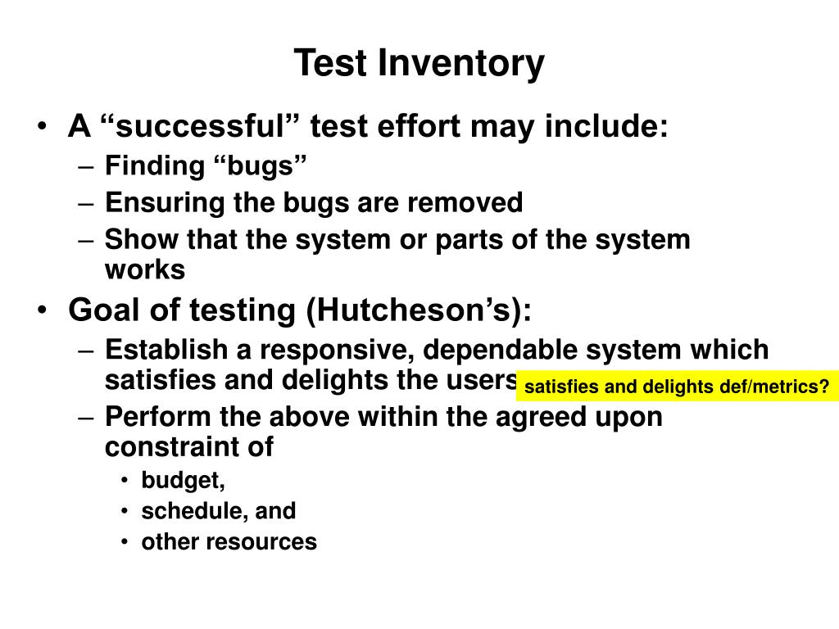

Slide 7
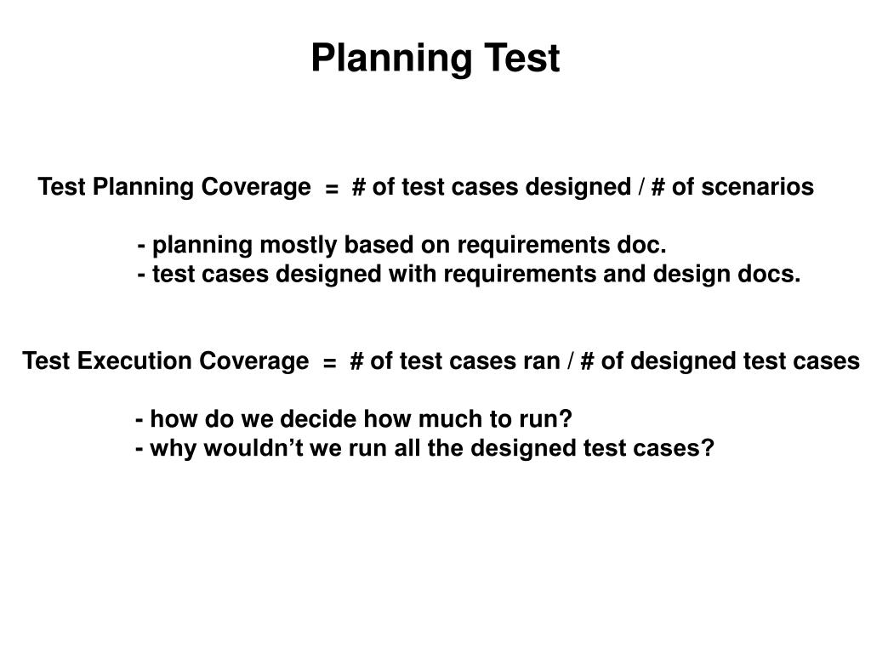

Slide 8
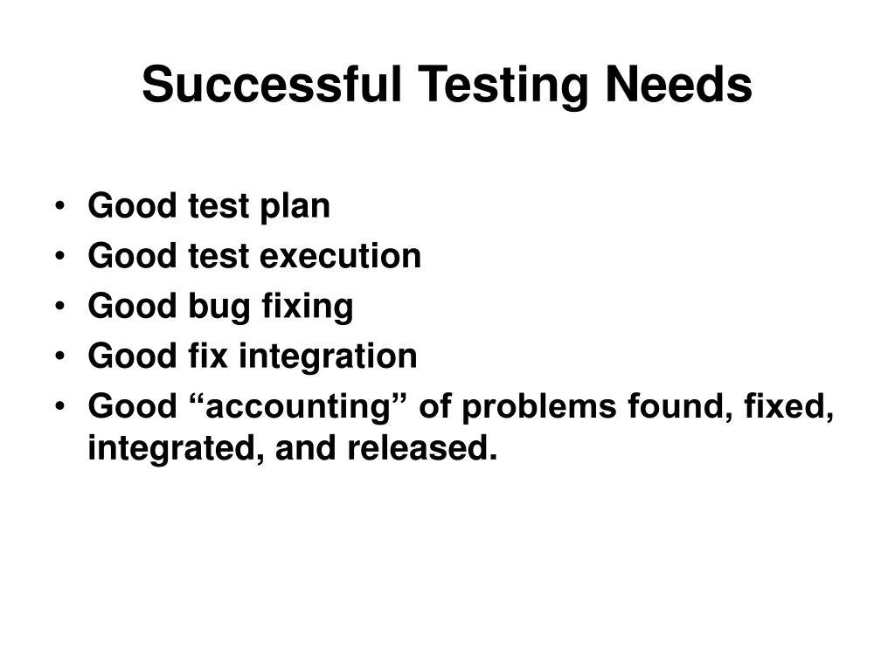

Slide 9
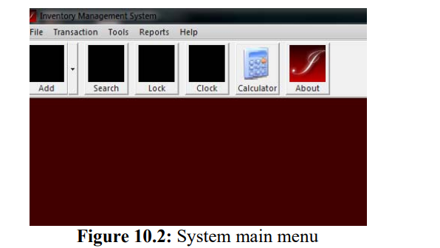
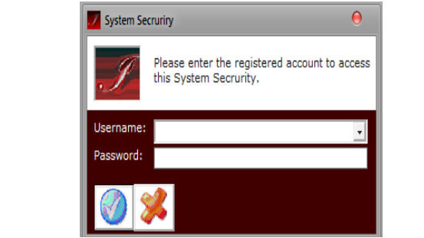
Result
The result of the test is stored in the database. Especially the details of the report will be generated in a form showing the details of available stocks and products.
10.1 Sample Outputs for Inventory Management

Slide 10
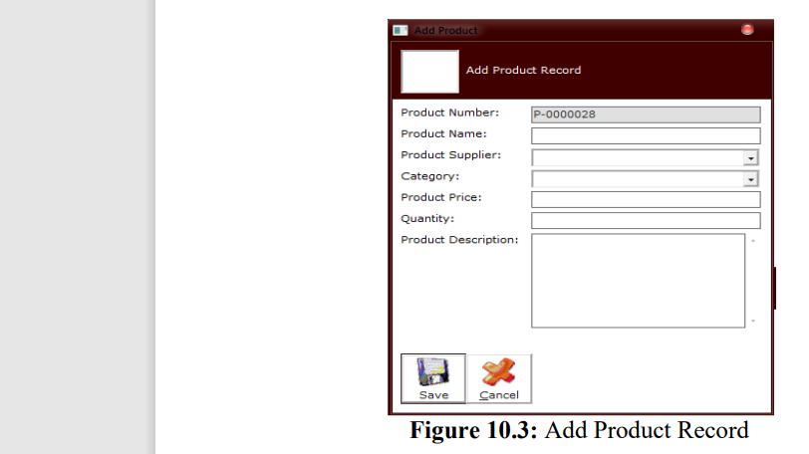
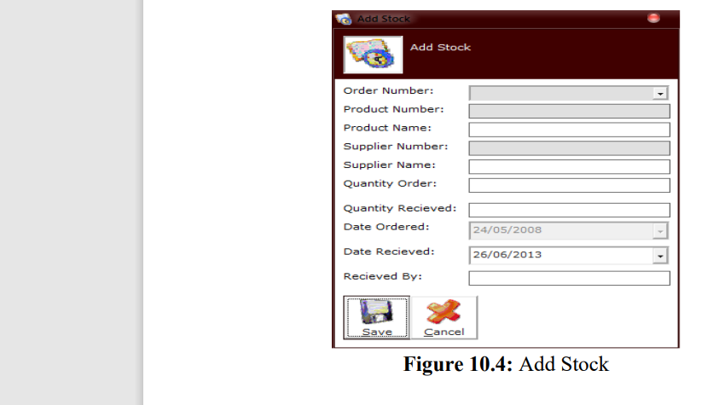
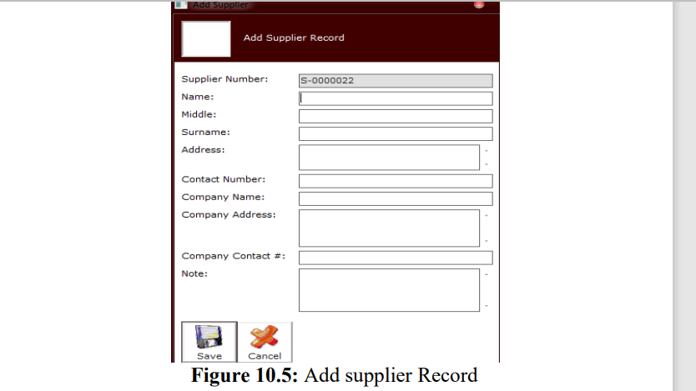

Slide 11
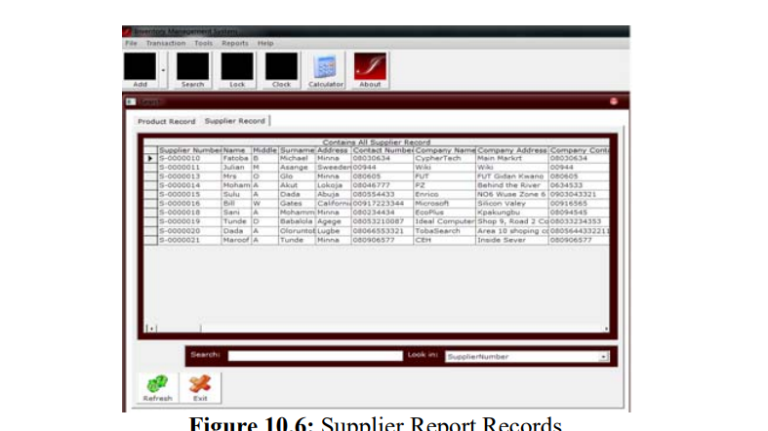
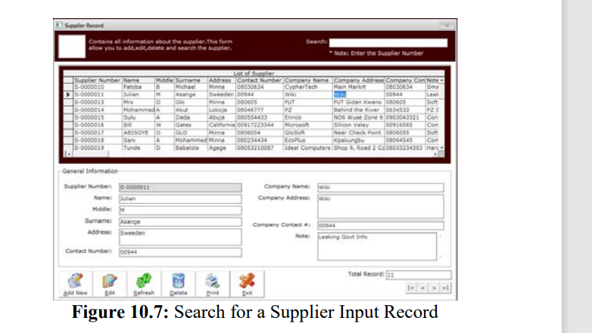

Slide 12
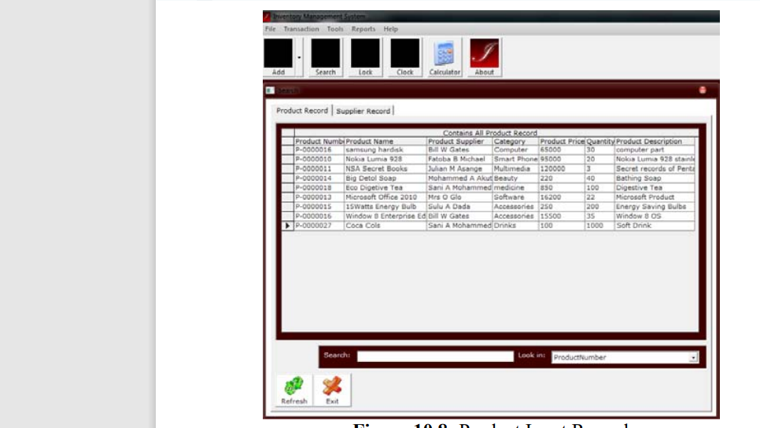

Slide 13
THANKYOU

